Slide 1

Fashion-MNIST Classification Using ANN and CNN
Name Huzaifa Pervaiz
Course Master’s in ai

Slide 2
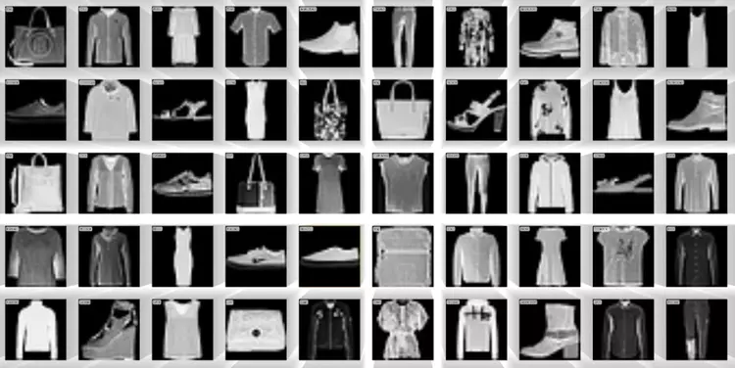
Introduction
Background / Context: Deep learning has become a key technique in artificial intelligence, allowing computers to recognize and interpret visual data effectively. Among various models, neural networks like ANN and CNN are widely used for image classification tasks.
• Why this topic was chosen: The Fashion-MNIST dataset provides a practical and challenging benchmark for evaluating image recognition models. By comparing ANN and CNN on this dataset, we can gain a deeper understanding of how architectural differences impact learning and performance.
• Problem / Research Question: Can a CNN significantly outperform an ANN on image classification tasks due to its ability to capture spatial patterns and visual features?

Slide 3
Objectives
• Main Objectives: To compare the performance of Artificial Neural Networks (ANN) and Convolutional Neural Networks (CNN) in classifying images from the Fashion-MNIST dataset.
• What the Project Aims to Demonstrate: To show how CNNs outperform ANNs by effectively capturing spatial and visual features such as edges, textures, and shapes — leading to higher accuracy and better generalization.
• Expected Outcomes / Benefits: A deeper understanding of how network architecture influences learning behavior, performance metrics, and image recognition capability — highlighting the strengths of CNNs for computer vision tasks.

Slide 4
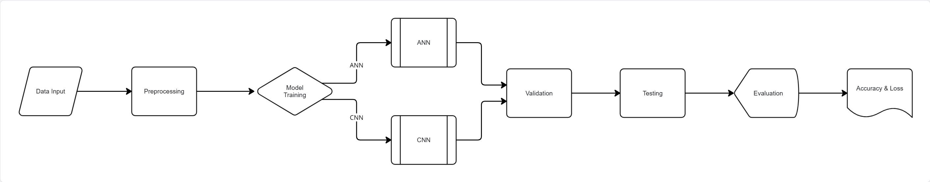
Methodology
Overview of How the Work Was Carried Out: The project involved training and evaluating two deep learning models — an Artificial Neural Network (ANN) and a Convolutional Neural Network (CNN) — on the Fashion-MNIST dataset. The dataset was divided into training (80%), validation (20%), and test sets to ensure fair performance comparison.
• Tools, Techniques, or Methods Used:
Frameworks: PyTorch, NumPy, Matplotlib.
Optimizer: Adam with a learning rate of 0.001.
Loss Function: CrossEntropyLoss.
Epochs: 65 training iterations for both models.
Regularization: Dropout layers added to prevent overfitting.

Slide 5
Data/ Source
• Data Sources, Materials, or Resources Used: The project utilized the Fashion-MNIST dataset, which contains 70,000 grayscale images of clothing items divided into 10 categories, such as T-shirt, Trouser, Dress, and Sneaker. The dataset was imported directly using TorchVision Datasets from the PyTorch library.
• Preprocessing, Setup, or Preparation Done:
Each image (28×28 pixels) was normalized to a range of [-1, 1].
Data was split into training (80%), validation (20%), and testing sets.
Batch size: 64 for efficient computation.
Applied transformations using transforms.Compose() for consistency in training.
• Key Assumptions or Parameters:
The dataset is representative of common fashion categories.
Random seed values were fixed for reproducibility.
Training and validation processes assume consistent model hyperparameters and no data leakage.

Slide 6
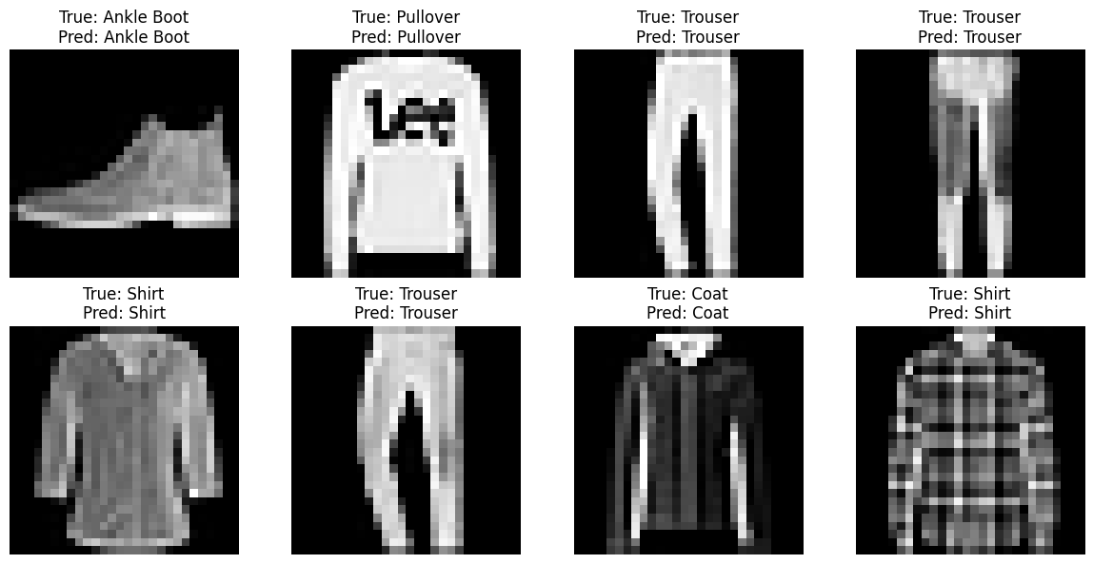
Implementation
• Step-by-step outline
Load Fashion-MNIST via TorchVision and apply transforms (ToTensor, Normalize).
Split dataset: 80% train / 20% validation, keep test set separate.
Build models:
ANN: flatten → Dense(256) → ReLU → Dropout(0.3) → Dense(128) → Dense(64) → Output(10).
CNN: Conv(32) → ReLU → Pool → Conv(64) → ReLU → Pool → Flatten → Dense(128) → Dropout(0.5) → Output(10).
Configure training: CrossEntropyLoss, Adam optimizer (lr=0.001), batch_size=64, epochs=65.
Train each model, record training & validation loss/accuracy per epoch.
Evaluate on test set: compute test loss, test accuracy, and class confusion matrices.
Visual checks: plot loss/accuracy curves, show sample predictions and confusion matrices.
• Important stages / milestones
Data split & preprocessing completed (ensures fair comparison).
Model implementation verified with a small forward pass.
Training baseline after 10 epochs to sanity-check learning.
Full training to 65 epochs, producing stable curves.
Final evaluation: test accuracy & confusion matrices (used for analysis).
Sample Predictions

Slide 7
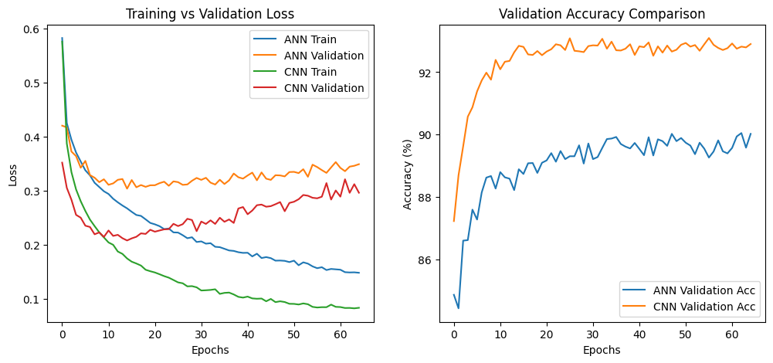
Results
• Key Results, Outputs, or Observations:
ANN: Test Accuracy = 89.32%, Test Loss = 0.3724
CNN: Test Accuracy = 92.39%, Test Loss = 0.3386
CNN showed smoother learning curves and faster convergence.
Both models learned effectively, but CNN achieved higher generalization on unseen data.
• Graphs, Tables, or Visuals Summarizing Outcomes:
(Insert visual) graphs.png → Training & Validation Loss and Accuracy curves.
(Insert visual) 1.png (ANN) and 2.png (CNN) → Confusion matrices for class-wise accuracy comparison.
• Comparison Between Expected and Actual Results:
Expected: CNN to outperform ANN due to convolutional feature extraction.
Actual: CNN achieved ~3% higher test accuracy, confirming its advantage in visual pattern recognition.
ANN performed well but struggled with visually similar categories like Shirt, Coat, and Pullover.

Slide 8
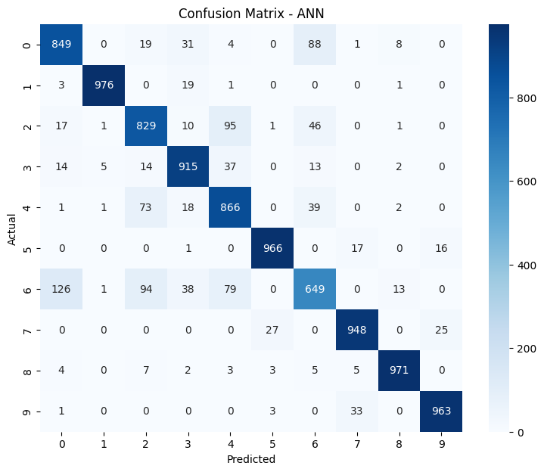
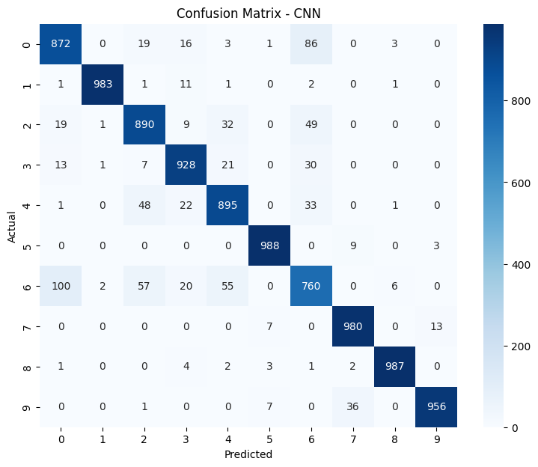
Discussion
• What Do the Results Mean?
The results confirm that Convolutional Neural Networks (CNNs) are better suited for image classification tasks than Artificial Neural Networks (ANNs).
CNNs efficiently learn spatial hierarchies and visual features like edges and textures, which improves recognition accuracy.
ANNs process flattened pixel data and therefore lose spatial relationships, reducing classification precision.
• Insights, Patterns, or Key Takeaways:
CNN achieved higher accuracy (92.39%) and lower loss (0.3386), proving better generalization.
Confusion matrices showed CNN made fewer mistakes, especially for visually similar classes (e.g., Shirt vs Coat).
Dropout and validation monitoring helped prevent overfitting in both models.
Training curves demonstrated steady convergence for CNN and mild fluctuations for ANN near the end of training.
• Challenges Encountered and How They Were Handled:
Challenge: Slight overfitting in ANN after 50+ epochs. Solution: Added dropout layers (0.3) to improve regularization.
Challenge: Ensuring balanced class representation during training. Solution: Used random shuffling and batch normalization through PyTorch DataLoader.
Challenge: Maintaining consistent comparison. Solution: Both models were trained under identical hyperparameters and evaluation metrics.

Slide 9

Conclusion
• Recap of What Was Achieved: Implemented and compared ANN and CNN models on the Fashion-MNIST dataset, analyzing accuracy and loss.
• Key Points Learned:
CNN achieved higher accuracy and better generalization.
ANN performed well but lacked spatial feature learning.
Dropout improved stability and reduced overfitting.
• Broader Contribution: The project demonstrates how model architecture impacts learning performance and highlights CNNs’ strength in visual recognition tasks.

Slide 10
Future Work
• Suggestions for Improvement / Future Directions:
Apply data augmentation (rotations, flips) to improve generalization.
Experiment with different optimizers (e.g., SGD, RMSProp).
Explore deeper CNN architectures or transfer learning (e.g., ResNet).
• Acknowledgments: Grateful for the guidance and resources provided by the Neural Networks module instructor and the use of PyTorch and TorchVision libraries for implementation.
• References / Tools:
Dataset: Fashion-MNIST by Zalando Research
Libraries: PyTorch, NumPy, Matplotlib

